Slide 1
CS212-Object Oriented Programming
Lecture 07
Inheritance & Polymorphism
Study with Chapter 11 of Course Book

Slide 2
Inheritance
Inheritance is a mechanism in which one object acquires all the properties and behaviors of parent object.
The idea behind inheritance in java is that you can create new classes that are built upon existing classes.
When you inherit from an existing class, you can reuse methods and fields of parent class, and you can add new methods and fields also.
Inheritance represents the IS-A relationship, also known as parent-child relationship.
Defining a new class based on an existing class is called derivation.
The derived class is also called the direct subclass of the base or super class.
You can also derive classes from the derived class and so on.
Class A
Class B
Class C
Notes:
1-> Inheritance as Parent-Child relationships where you go from generic to specific class implementation as you move down the hierarchy chain.
---E.g. For college management systems we defined Person to be the parent class containing CNIC, Gender, Name, Course etc attributes and Students, Staff, Faculty to be children of the Person Class
---Similarly Vehicle was defined to be parent class for Car, Bus, Wagon, Bike etc children classes.
2-> Let me mention here, Java does not support multiple inheritance i.e. A child class belonging to two parent classes. Unlike C++
3-> Specific methods go to the child class
4-> A student is a person, A car is a vehicle etc
5-> B is derived from A
6-> A is a superclass or base-class for both B and C.
7-> Vehicle->Car->Honda->Civic

Slide 3
Inheritance
A programmer can tailor a derived class as needed by adding new variables or methods, or by providing new declaration or implementation for the inherited ones.
Software reuse is a fundamental benefit of inheritance.
By using existing software components to create new ones, we capitalize on all the effort that went into the design, implementation, and testing of the existing software.
class B extends A {
// definition of class B
}
The extends keyword indicates that you are making a new class that derives from an existing class.
In the terminology of Java, a class that is inherited is called a super class. The new class is called a subclass.
The class B can have additional members in addition to the inherited members of class A.
Notes:
1-> Laptop is a computer but has portability
--- Altis has +CruiseTronic #1.8L Engine
2-> U define general attributes and methods in the base/ super class
3-> A is already tested and u r just deriving a subclass.
---Think if you copied A and started adjusting (Retest everything)

Slide 4
Inheritance
Programmer is the subclass and Employee is the superclass. Relationship between two classes is Programmer IS-A Employee. It means that Programmer is a type of Employee.
Programmer object can access the fields of own class as well as of Employee class i.e. code reusability.
class Employee {
public float salary = 40000;
}
class Programmer extends Employee {
public int bonus = 10000;
}
public static void main(String[] args) {
Programmer p = new Programmer();
System.out.println("Programmer salary is: " + p.salary);
System.out.println("Bonus of Programmer is: " + p.bonus);
}

Slide 5
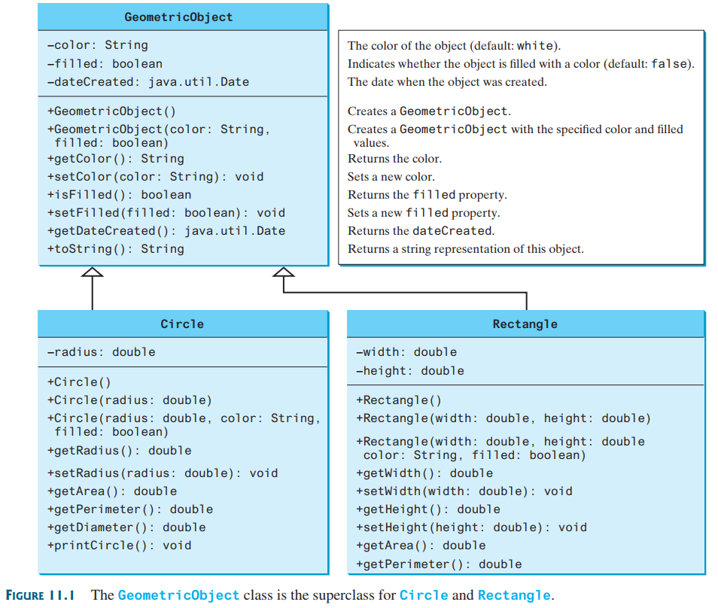
Inheritance
Notes:
See section 11.2 of the book for implementation.

Slide 6
Inheritance
An inherited member of a base class is one that is accessible within the derived class.
Base class members that are not inherited still form part of a derived class object.
An inherited member of a derived class is a full member of that class and is freely accessible to any method in the class.
The inheritance rules apply to class variables as well as instance variables.
Which members of the base class are inherited?
Package2
Pakage1
SubClass
public BaseClass
SubClass
int a
public int b;
protected int c;
private int d;
Notes:
1-> public/ protected
2-> private
3-> u can write a function that uses the public data field of superclass
--- getAge function defined for person is accessible to student
4-> class variables == static variables

Slide 7
Protected Modifier
Access modifiers affect the way that class members can be used in a child class.
Variables and methods declared with private visibility cannot be referenced by name in a child class.
They can be referenced in the child class if they are declared with public visibility – but public variables violate the principle of encapsulation.
There is a third visibility modifier that helps in inheritance situations: protected.
The protected modifier allows a child class to reference a variable or method directly in the child class.
It provides more encapsulation than public visibility, but is not as tightly encapsulated as private visibility.
The protected access modifier is accessible within package and outside the package but through inheritance only.
The protected access modifier can be applied on the data members, methods and constructors. It can't be applied on the class.
Notes:
Private – Default – Protected – Public
Within class – Within package – outside package by subclass only – Outside package

Slide 8
Example(Protected Modifier)
package mypack;
import pack.*;
class B extends A {
public static void main(String[] args) {
B obj = new B();
obj.msg();
}
}
package pack;
public class A {
protected void msg() {
System.out.println("Hello");
}
}

Slide 9
The super Keyword in Java
The super keyword in Java is a reference variable that is used to refer to the immediate parent class object.
Whenever you create the instance of subclass, an instance of parent class is created implicitly i.e. referred by super reference variable.
Usage of Java super Keyword
The super is used to refer to the immediate parent class instance variable.
The super() is used to invoke immediate parent class constructor.
The super is used to invoke immediate parent class method.

Slide 10
Inheriting Data Members
A data member in a derived class can be defined with the same name as data member in the base class.
The data member of the base class is still inherited but is hidden by the derived class member with the same name.
Any use of the derived member name will always refer to the member defined in derived class.
To refer to the inherited base class member, you must qualify it with the keyword super.
Note that you cannot use super.super.something

Slide 11
Inheriting Data Members
class Vehicle {
int speed = 50;
}
class Bike extends Vehicle {
int speed = 100;
void display() {
System.out.println(super.speed);
}
public static void main(String[] args) {
Bike b = new Bike();
b.display();
}
}
In the above example Vehicle and Bike both classes have a common property speed.
Instance variable of current class is referred directly.
However, to refer parent class instance variable inside the derived class, we use super keyword to distinguish between parent class instance variable and current class instance variable.

Slide 12
Inheriting Methods
Methods in a base class excluding constructors are inherited in a derived class in the same way as the data members of the base class
Methods declared as private in a base class are not inherited
Note: Constructors in the base class are never inherited regardless of their attributes.
Though the base class constructors are not inherited in your derived class, you can still call them or if you don’t call a base class constructor from your derived class constructor, the compiler will try to do it for you.
The super class constructor is called in a subclass using super();

Slide 13
Inheriting Methods
As we know well that default constructor is provided by compiler automatically but it also adds super() for the first statement.
If you are creating your own constructor and you don't have either this() or super() as the first statement, compiler will provide super() as the first statement of the constructor.
class Vehicle {
Vehicle() {
System.out.println("Vehicle is created");
}
}
class Bike extends Vehicle {
Bike() {
super();
System.out.println("Bike is created");
}
public static void main(String[] args) {
Bike b = new Bike();
}
}
Note: super() is added in each class constructor automatically by compiler
Notes:
Q. Can we overwrite the super() with some multi-argument constructor of the parent class e.g. super(234, ‘Khawir’)?
Q. In case of multi-level inheritance, will super() be chained?
Q. 2 classes in 1 file? If yes, what will be the name of the file?

Slide 14
Inheriting Methods
class Person {
void message() {
System.out.println("Welcome");
}
}
class Student extends Person {
void message() {
System.out.println("Welcome to Java");
}
void display() {
message();
super.message();
}
public static void main(String[] args) {
Student s = new Student();
s.display();
}
}
Notes:
here i have changed a little bit of code.....see it
class Parent1 {
public void m1() {
System.out.println("PARENT");
}
}
class Child1 extends Parent1 {
public void m1(String t) {
System.out.println("CHILD");
}
}
public class PolyTest {
public static void main(String[] args) {
Parent1 p = new Child1();
p.m1();
//((Parent1)p).m1(); ----> now this will work
}
}
here object is of type child1,and refernce is of type parent1. but this is the case of overloaded method...in this refernce type determines which method to invoke not a object type.... i think interviewer ask a tricky question

Slide 15
Calling Super Class Constructor
You must use the keyword super() to call the super class constructor.
Invoking a super class constructor’s name in a subclass causes a syntax error.
Java requires that the statement that uses the keyword super() appear first in the constructor.

Slide 16
Constructor Chaining
public class Faculty extends Employee {
public static void main(String[] args) {
Faculty f = new Faculty();
}
public Faculty() {
System.out.println(
"(4) Faculty's no-arg constructor is invoked");
}
}
class Employee extends Person {
public Employee() {
this("(2) Invoke Employee's overloaded constructor");
System.out.println(
"(3) Employee's no-arg constructor is invoked");
}
public Employee(String s) {
System.out.println(s);
}
}
class Person {
public Person() {
System.out.println(
"(1) Person's no-arg constructor is invoked");
}
}

Slide 17
Constructor Chaining
public class Faculty extends Employee {
public static void main(String[] args) {
Faculty f = new Faculty();
}
public Faculty() {
System.out.println(
"(4) Faculty's no-arg constructor is invoked");
}
}
class Employee extends Person {
public Employee() {
this("(2) Invoke Employee's overloaded constructor");
System.out.println(
"(3) Employee's no-arg constructor is invoked");
}
public Employee(String s) {
System.out.println(s);
}
}
class Person {
public Person() {
System.out.println(
"(1) Person's no-arg constructor is invoked");
}
}
Constructing an instance of a class invokes all the super classes’ constructors along the inheritance chain.
This is called constructor chaining.

Slide 18
Constructor Chaining
public class Faculty extends Employee {
public static void main(String[] args) {
Faculty f = new Faculty();
}
public Faculty() {
System.out.println(
"(4) Faculty's no-arg constructor is invoked");
}
}
class Employee extends Person {
public Employee() {
this("(2) Invoke Employee's overloaded constructor");
System.out.println(
"(3) Employee's no-arg constructor is invoked");
}
public Employee(String s) {
System.out.println(s);
}
}
class Person {
public Person() {
System.out.println(
"(1) Person's no-arg constructor is invoked");
}
}
1. Start from the main method

Slide 19
Constructor Chaining
public class Faculty extends Employee {
public static void main(String[] args) {
Faculty f = new Faculty();
}
public Faculty() {
System.out.println(
"(4) Faculty's no-arg constructor is invoked");
}
}
class Employee extends Person {
public Employee() {
this("(2) Invoke Employee's overloaded constructor");
System.out.println(
"(3) Employee's no-arg constructor is invoked");
}
public Employee(String s) {
System.out.println(s);
}
}
class Person {
public Person() {
System.out.println(
"(1) Person's no-arg constructor is invoked");
}
}
2. Invoke Faculty() constructor

Slide 20
Constructor Chaining
public class Faculty extends Employee {
public static void main(String[] args) {
Faculty f = new Faculty();
}
public Faculty() {
System.out.println(
"(4) Faculty's no-arg constructor is invoked");
}
}
class Employee extends Person {
public Employee() {
this("(2) Invoke Employee's overloaded constructor");
System.out.println(
"(3) Employee's no-arg constructor is invoked");
}
public Employee(String s) {
System.out.println(s);
}
}
class Person {
public Person() {
System.out.println(
"(1) Person's no-arg constructor is invoked");
}
}
3. Invoke Employee’s no-arg constructor

Slide 21
Constructor Chaining
public class Faculty extends Employee {
public static void main(String[] args) {
Faculty f = new Faculty();
}
public Faculty() {
System.out.println(
"(4) Faculty's no-arg constructor is invoked");
}
}
class Employee extends Person {
public Employee() {
this("(2) Invoke Employee's overloaded constructor");
System.out.println(
"(3) Employee's no-arg constructor is invoked");
}
public Employee(String s) {
System.out.println(s);
}
}
class Person {
public Person() {
System.out.println(
"(1) Person's no-arg constructor is invoked");
}
}
4. Invoke Employee(String) constructor using this keyword

Slide 22
Constructor Chaining
public class Faculty extends Employee {
public static void main(String[] args) {
Faculty f = new Faculty();
}
public Faculty() {
System.out.println(
"(4) Faculty's no-arg constructor is invoked");
}
}
class Employee extends Person {
public Employee() {
this("(2) Invoke Employee's overloaded constructor");
System.out.println(
"(3) Employee's no-arg constructor is invoked");
}
public Employee(String s) {
System.out.println(s);
}
}
class Person {
public Person() {
System.out.println(
"(1) Person's no-arg constructor is invoked");
}
}
5. Invoke Person() constructor

Slide 23
Constructor Chaining
public class Faculty extends Employee {
public static void main(String[] args) {
Faculty f = new Faculty();
}
public Faculty() {
System.out.println(
"(4) Faculty's no-arg constructor is invoked");
}
}
class Employee extends Person {
public Employee() {
this("(2) Invoke Employee's overloaded constructor");
System.out.println(
"(3) Employee's no-arg constructor is invoked");
}
public Employee(String s) {
System.out.println(s);
}
}
class Person {
public Person() {
System.out.println(
"(1) Person's no-arg constructor is invoked");
}
}
6. Execute println

Slide 24
Constructor Chaining
public class Faculty extends Employee {
public static void main(String[] args) {
Faculty f = new Faculty();
}
public Faculty() {
System.out.println(
"(4) Faculty's no-arg constructor is invoked");
}
}
class Employee extends Person {
public Employee() {
this("(2) Invoke Employee's overloaded constructor");
System.out.println(
"(3) Employee's no-arg constructor is invoked");
}
public Employee(String s) {
System.out.println(s);
}
}
class Person {
public Person() {
System.out.println(
"(1) Person's no-arg constructor is invoked");
}
}
7. Execute println

Slide 25
Constructor Chaining
public class Faculty extends Employee {
public static void main(String[] args) {
Faculty f = new Faculty();
}
public Faculty() {
System.out.println(
"(4) Faculty's no-arg constructor is invoked");
}
}
class Employee extends Person {
public Employee() {
this("(2) Invoke Employee's overloaded constructor");
System.out.println(
"(3) Employee's no-arg constructor is invoked");
}
public Employee(String s) {
System.out.println(s);
}
}
class Person {
public Person() {
System.out.println(
"(1) Person's no-arg constructor is invoked");
}
}
8. Execute println

Slide 26
Constructor Chaining
public class Faculty extends Employee {
public static void main(String[] args) {
Faculty f = new Faculty();
}
public Faculty() {
System.out.println(
"(4) Faculty's no-arg constructor is invoked");
}
}
class Employee extends Person {
public Employee() {
this("(2) Invoke Employee's overloaded constructor");
System.out.println(
"(3) Employee's no-arg constructor is invoked");
}
public Employee(String s) {
System.out.println(s);
}
}
class Person {
public Person() {
System.out.println(
"(1) Person's no-arg constructor is invoked");
}
}
9. Execute println

Slide 27
Constructor Chaining
If the first statement in a derived class constructor is not a call to a base class constructor, the compiler will insert a call to the class’s default constructor i.e. super().
This sometimes results in a compiler error, because – when we define our own constructor in a class, then no default constructor is created by the compiler.
Thus we need to define the no argument constructor for the class, so that in a derived class we don’t get the compile error due to call to default constructor of base class.

Slide 28
Constructor Chaining
public class Person {
protected String name;
protected String address;
/* Default constructor */
public Person() {
System.out.println("Inside Person:Constructor");
name = "";
address = "";
}
}
public class Student extends Person {
public Student() {
System.out.println("Inside Student:Constructor");
}
}
public class Demo {
public static void main(String[] args) {
Student Ali = new Student();
}
}
Notes:
Try a person argument constructor called in student via super

Slide 29
The super() keyword
A subclass can also explicitly call a constructor of its immediate super class.
This is done by using the super() constructor call.
A super constructor call in the constructor of a subclass will result in the execution of relevant constructor from the super class, based on the arguments passed.
Few things to remember when using the super constructor call:
The super() call must occur as the first statement in a constructor.
The super() call can only be used in a constructor (not in ordinary methods).

Slide 30
The super() keyword
public class Person {
protected String name;
protected String address;
public Person() {
System.out.println("Inside Person:Constructor1");
name = ""; address = "";
}
public Person(String name, String address) {
System.out.println("Inside Person:Constructor2");
this.name = name; this.address = address;
}
}
public class Student extends Person {
public Student() {
super("SomeName", "SomeAddress");
System.out.println("Inside Student:Constructor");
}
}
public class Demo {
public static void main(String[] args) {
Student Ali = new Student();
}
}

Slide 31
The super() keyword
public class Person {
protected String name;
protected String address;
public Person() {
System.out.println("Inside Person:Constructor");
name = ""; address = "";
}
}
public class Student extends Person {
public Student() {
super.name = "SomeName";
super.address = "SomeAddress";
System.out.println("Inside Student:Constructor");
}
}
public class Demo {
public static void main(String[] args) {
Student Ali = new Student();
}
}
Notes:
class Person {
protected String name;
protected String address;
public Person() {
System.out.println("Inside Person:Constructor");
name = "aName"; address = "anAddress";
}
}
class Student extends Person {
protected String name;
protected String address;
public Student() {
name = "SomeName";
address = "SomeAddress";
System.out.println("Inside Student:Constructor");
}
public void display() {
System.out.println(super.name + " lives at " + super.address);
}
}
public class Demo {
public static void main(String[] args) {
Student Ali = new Student();
Ali.display();
System.out.println(Ali.name);
}
}

Slide 32
Method Overriding
If subclass (child class) has the same method as declared in the parent class, it is known as method overriding in java.
In other words, If subclass provides the specific/ new implementation of the method that has been provided by one of its parent class, it is known as method overriding.
Usage of Java Method Overriding
Method overriding is used to provide specific implementation of a method that is already provided by its super class.
Method overriding is used for runtime polymorphism.
Rules for Java Method Overriding
method must have same name as in the parent class.
method must have same parameter as in the parent class.
must be IS-A relationship (inheritance).

Slide 33
Example (Method Overriding)
To override a method, the method must be defined in the subclass using the same signature as in its superclass.
The name and parameter of the method is same and there is IS-A relationship between the classes, so there is method overriding.
class Vehicle {
void run() {
System.out.println("Vehicle is running");
}
}
class Bike extends Vehicle {
void run() {
System.out.println("Bike is running safely");
}
public static void main(String[] args) {
Bike obj = new Bike();
obj.run();
}
}

Slide 34
Example 2
class Test2 {
public static void main(String[] args) {
HBL h = new HBL();
UBL u = new UBL();
ABL a = new ABL();
System.out.println("HBL Rate of Interest: " +
h.getRateOfInterest());
System.out.println("UBL Rate of Interest: " +
u.getRateOfInterest());
System.out.println("ABL Rate of Interest: " +
a.getRateOfInterest());
}
}
class Bank {
int getRateOfInterest() { return 0; }
}
class HBL extends Bank {
int getRateOfInterest() { return 8; }
}
class UBL extends Bank {
int getRateOfInterest() { return 7; }
}
class ABL extends Bank {
int getRateOfInterest() { return 9; }
}

Slide 35
Method Overriding
Following methods cannot be overridden.
A Static method cannot be overridden. Because static method is bound with class whereas instance method is bound with object.
We cannot override the main method. Because main method is static.

Slide 36
Method Overloading
If a class have multiple methods by same name but different parameters, it is known as Method Overloading.
Suppose you have to perform addition of the given numbers but there can be any number of arguments, if you write the method such as a(int ,int) for two parameters, and b(int, int, int) for three parameters then it may be difficult for you as well as other programmers to understand the behavior of the method because its name differs. So, we perform method overloading to figure out the program quickly.
Different ways to Overload a method
By changing number of arguments
By changing the data type
Note: In java, Method Overloading is not possible by changing the return type of the method.

Slide 37
Method Overloading
Changing the number of arguments
class Calculation {
void sum(int a, int b) {
System.out.println(a + b);
}
void sum(int a, int b, int c) {
System.out.println(a + b + c);
}
public static void main(String[] args) {
Calculation obj = new Calculation();
obj.sum(10, 10, 10);
obj.sum(20, 20);
}
}

Slide 38
Method Overloading
Changing data types of arguments
class Calculation {
void sum(int a, int b) {
System.out.println(a + b);
}
void sum(double a, double b) {
System.out.println(a + b);
}
public static void main(String[] args) {
Calculation obj = new Calculation ();
obj.sum(10.5, 10.5);
obj.sum(20,20);
}
}

Slide 39
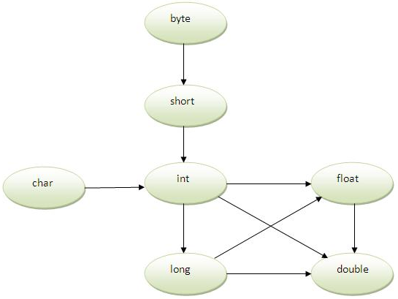
Method Overloading and Type Promotion
Type Promotion specifies that a small size datatype can be promoted to a large size datatype. i.e., an Integer data type can be promoted to long, float, double, etc. This Automatic Type Promotion is done when any method which accepts a higher size data type argument is called with the smaller data type.

Slide 40
Method Overloading and Type Promotion
class Calculation {
void sum(int a, long b) {
System.out.println(a + b);
}
void sum(int a, int b, int c) {
System.out.println(a + b + c);
}
public static void main(String[] args) {
Calculation obj = new Calculation();
// now second int literal
// will be promoted to long
obj.sum(20, 20);
obj.sum(20, 20, 20);
}
}

Slide 41
Method Overloading vs. Method Overriding
# | Method Overloading | Method Overriding
1 | Method overloading is used to increase the readability of the program | Method overriding is used to provide the specific implementation of the method that is already provided by its super class.
2 | Method overloading is performed within class. | Method overriding occurs in two classes that have IS-A (inheritance) relationship.
3 | In case of method overloading, parameter must be different. | In case of method overriding, parameter must be same.
4 | Method overloading is the example of compile time polymorphism. | Method overriding is the example of run time polymorphism.
5 | In java, method overloading can't be performed by changing return type of the method only. Return type can be same or different in method overloading. But you must have to change the parameter. | Return type must be same or covariant in method overriding.

Slide 42
Final Keyword In Java
The final keyword in java is used to restrict the user.
The java final keyword can be used in many context:-
Variables
Methods
Classes
The final keyword can be applied with the variables.
A final variable that has no value – is called blank final variable or uninitialized final variable.
It can be initialized in the constructor only.
If you make any variable as final, you cannot change the value of final variable (It will be constant).

Slide 43
Final Variable
class Bike {
// final variable
final int speedlimit = 90;
void run() {
// Error. Cannot change final Variable
speedlimit = 400;
}
public static void main(String[] args) {
Bike obj = new Bike();
obj.run();
}
}

Slide 44
Final Method
If you make any method as final, you cannot override it.
class Bike {
final void run() {
System.out.println("running");
}
}
class Honda extends Bike {
// ERROR: Final method cannot be overridden
void run() {
System.out.println("running with 100kmph");
}
public static void main(String[] args) {
Honda honda = new Honda();
honda.run();
}
}

Slide 45
Final Class
If you make any class as final, you cannot extend it.
final class Bike {
void run() {
System.out.println("running");
}
}
// ERROR: Final class cannot be extended
class Honda extends Bike {
void run() {
System.out.println("running with 100kmph");
}
public static void main(String[] args) {
Honda honda = new Honda();
honda.run();
}
}

Slide 46
Inheritance of Final Methods
Final Method is inherited but final method cannot be overridden.
class Bike {
final void run() {
System.out.println("running...");
}
}
class Honda extends Bike {
public static void main(String[] args) {
Honda honda = new Honda();
honda.run();
}
}

Slide 47
Blank or uninitialized final Variables
A final variable that is not initialized at the time of declaration is known as blank final variable.
If you want to create a variable that is initialized at the time of creating object and once initialized may not be changed, it is useful. For example Reg# in Student Class – it can be initialized only in constructor.
public class Student {
private final int reg_no;
private String name;
private String address;
public Student(int r, String n, String a) {
reg_no = r;
name = n;
address = a;
}
public static void main(String[] args) {
Student s1 = new Student(111, "Omer", "Rwp");
Student s2 = new Student(222, "Hamza", "Rwp");
}
}

Slide 48
Final Parameters
If you declare any parameter as final, you cannot change the value of it. Example:-
public class MyMath {
int cube(final int n) {
// can't be changed as n is final
n = n + 2;
return n * n * n;
}
public static void main(String args[]) {
MyMath m = new MyMath();
int x = m.cube(5);
}
}

Slide 49
Static Final Variable
A static final variable that is not initialized at the time of declaration is known as static blank final variable.
It can be initialized only in static block.
class A{
static final int data;
static{ data=50;}
public static void main(String args[]){
System.out.println(A.data);
}
}

Slide 50

Object Class
In Java language, all classes are sub-classed (extended) from the Object super class.
Object class is the only class that does not have a parent class.
If no inheritance is specified when a class is defined, the superclass of the class is Object by
For example, the following two class definitions are the same:

Slide 51
Object Class
This class defines and implements behavior common to all classes including the ones that you write:-
getClass()
equals()
toString()
For example, overriding toString() method in a child class helps in providing descriptive string representation of the object.
equals() method can be used to implement test whether two objects are equal or not.

Slide 52
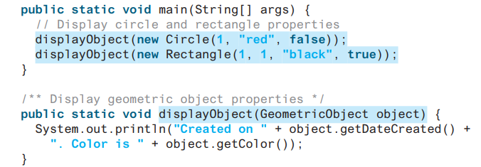

Polymorphism
Polymorphism means that a variable of a supertype can refer to a subtype object
It allows a variable of a Parent Class to refer an object of child class. A method can be implemented in several classes along the inheritance chain. The JVM decides which method is invoked at runtime based on the type of object the parent class variable holds.

Slide 53
Polymorphism
The process of associating a method definition with a method invocation is called binding
If the method definition is associated with its invocation when the code is compiled, that is called early binding or static binding
Function overloading is early binding
If the method definition is associated with its invocation when the method is invoked (at run time), that is called late binding or dynamic binding

Slide 54
Polymorphism
3 main programming mechanisms constitute OOP
Encapsulation
Inheritance
Polymorphism
Polymorphism is the ability to associate many meanings to one method name
It does this through a special mechanism known as late binding or dynamic binding

Slide 55
Polymorphism
The term polymorphism literally means "having many forms"
Single method call behaves differently depending on the type of the object which the call references
Polymorphism means
When a program invokes a method through a superclass variable, the correct subclass version of the method is called, based on the type of the reference stored in the superclass variable
The same method name and signature can cause different actions to occur, depending on the type of object on which the method is invoked
Facilitates adding new classes to a system with minimal modifications to the system’s code

Slide 56
Polymorphism
Runtime polymorphism or Dynamic Method Binding is a process in which a call to an overridden method is resolved at runtime rather than compile-time
The compiler only checks the compile time error and does not bind the method call with any actual method
This method binding if is done at runtime by runtime environment then we say dynamic polymorphism is being implemented in the program
An object reference can refer to an object of its class, or to an object of any class related to it by inheritance
For example, if the Holiday class is used to derive a class called Christmas, then a Holiday reference could be used to point to a Christmas object

Slide 57
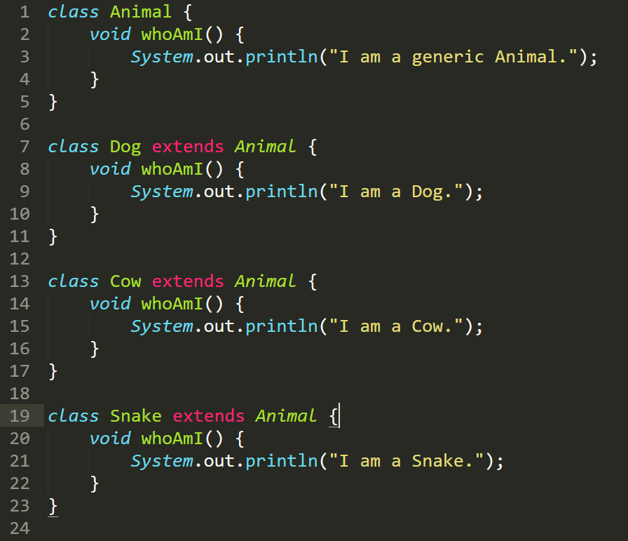
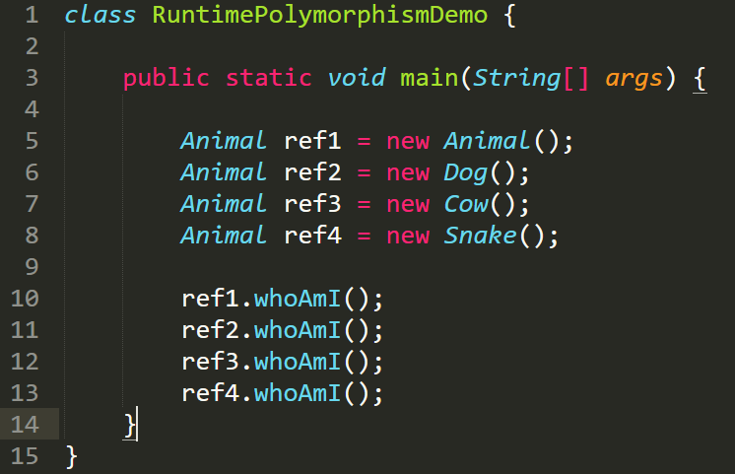
Polymorphism
I am Generic Animal.
I am Dog.
I am Cow.
I am Snake.

Slide 58
Polymorphism
UpCasting
Assigning a child object to a parent reference
Considered to be a widening conversion or Upcasting. Can be performed by simple assignment
Animal ref1 = new Dog();
Animal ref2 = new Cat();
DownCasting
Assigning a parent object to a child reference
Considered a narrowing conversion or Downcasting
Must be done with an explicit cast
Animal ref1 = new Dog();
Dog d = (Dog) ref1; //Works Fine
Cat c = (Cat) ref1; //Error, ref1 is of Dog type

Slide 59
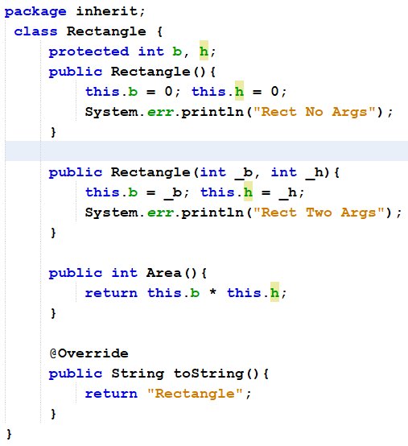
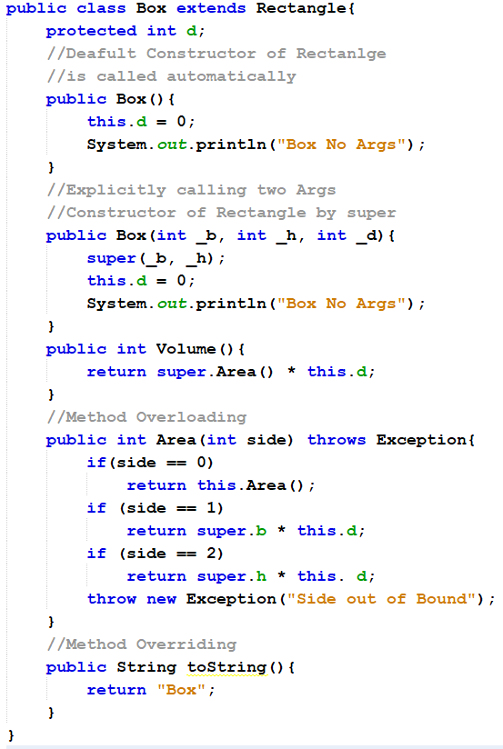
Code in Text
package inherit;
class Rectangle {
protected int b, h;
public Rectangle(){
this.b = 0; this.h = 0;
System.err.println("Rect No Args");
}
public Rectangle(int _b, int _h){
this.b = _b; this.h = _h;
System.err.println("Rect Two Args");
}
public int Area(){
return this.b * this.h;
}
@Override
public String toString(){
return "Rectangle";
}
}
package inherit;
public class Box extends Rectangle{
protected int d;
//Deafult Constructor of Rectanlge
//is called automatically
public Box(){
this.d = 0;
System.out.println("Box No Args");
}
//Explicitly calling two Args
//Constructor of Rectangle by super
public Box(int _b, int _h, int _d){
super(_b, _h);
this.d = 0;
System.out.println("Box No Args");
}
public int Volume(){
return super.Area() * this.d;
}
//Method Overloading
public int Area(int side) throws Exception{
if(side == 0)
return this.Area();
if (side == 1)
return super.b * this.d;
if (side == 2)
return super.h * this. d;
throw new Exception("Side out of Bound");
}
//Method Overriding
public String toString(){
return "Box";
}
}
Notes:
package inherit;
public class Box extends Rectangle{
protected int d;
//Deafult Constructor of Rectanlge
//is called automatically
public Box(){
this.d = 0;
System.out.println("Box No Args");
}
//Explicitly calling two Args
//Constructor of Rectangle by super
public Box(int _b, int _h, int _d){
super(_b, _h);
this.d = 0;
System.out.println("Box No Args");
}
public int Volume(){
return super.Area() * this.d;
}
//Method Overloading
public int Area(int side) throws Exception{
if(side == 0)
return this.Area();
if (side == 1)
return super.b * this.d;
if (side == 2)
return super.h * this. d;
throw new Exception("Side out of Bound");
}
//Method Overriding
public String toString(){
return "Box";
}
}

Slide 60
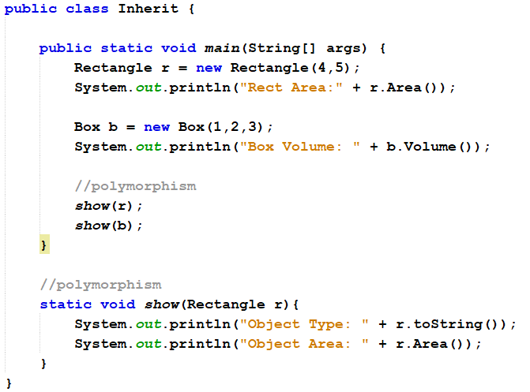
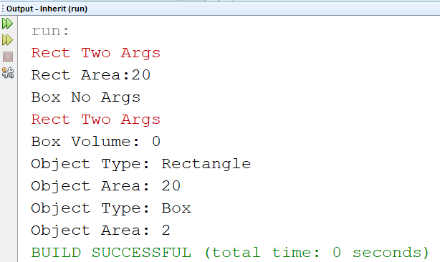
Code in Text
package inherit;
public class Inherit {
public static void main(String[] args) {
Rectangle r = new Rectangle(4,5);
System.out.println("Rect Area:" + r.Area());
Box b = new Box(1,2,3);
System.out.println("Box Volume: " + b.Volume());
//polymorphism
show(r);
show(b);
}
static void show(Rectangle r){
System.out.println("Object Type: " + r.toString());
System.out.println("Object Area: " + r.Area());
}
}
Notes:
package inherit;
public class Box extends Rectangle{
protected int d;
//Deafult Constructor of Rectanlge
//is called automatically
public Box(){
this.d = 0;
System.out.println("Box No Args");
}
//Explicitly calling two Args
//Constructor of Rectangle by super
public Box(int _b, int _h, int _d){
super(_b, _h);
this.d = 0;
System.out.println("Box No Args");
}
public int Volume(){
return super.Area() * this.d;
}
//Method Overloading
public int Area(int side) throws Exception{
if(side == 0)
return this.Area();
if (side == 1)
return super.b * this.d;
if (side == 2)
return super.h * this. d;
throw new Exception("Side out of Bound");
}
//Method Overriding
public String toString(){
return "Box";
}
}

Slide 61
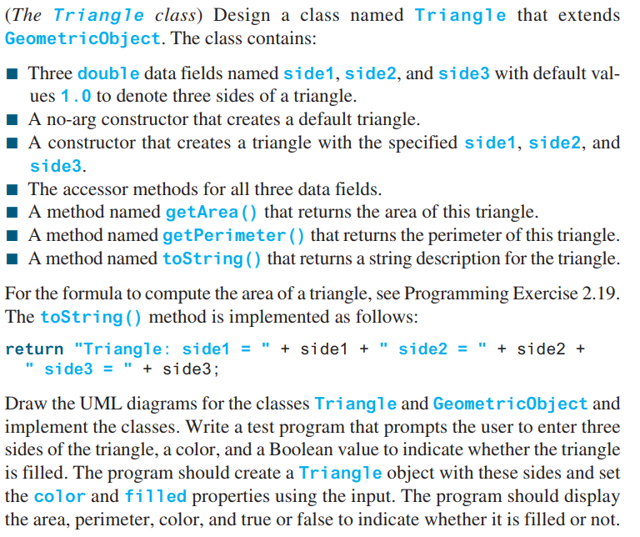
Practice

Slide 62
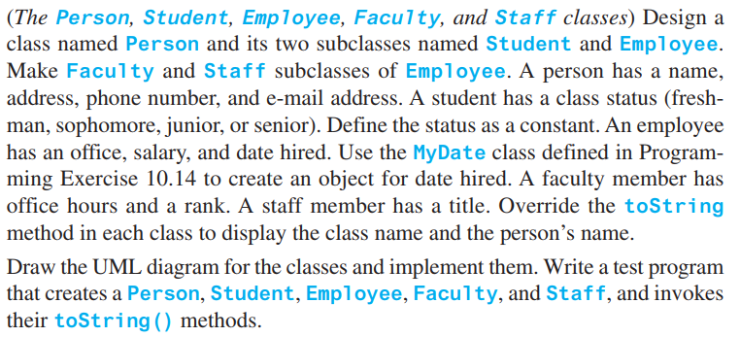
Practice

Slide 63
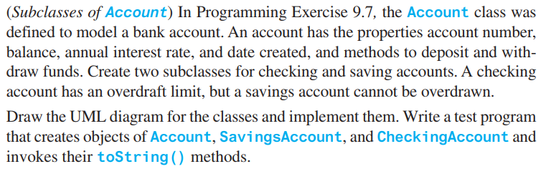
Practice

Slide 64
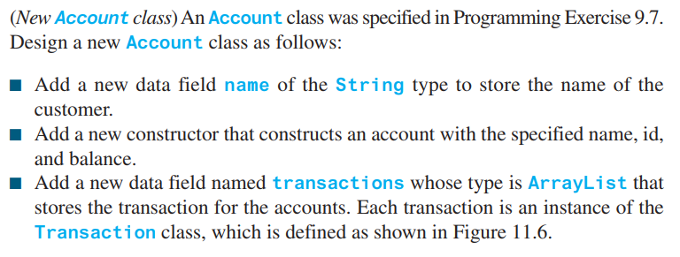
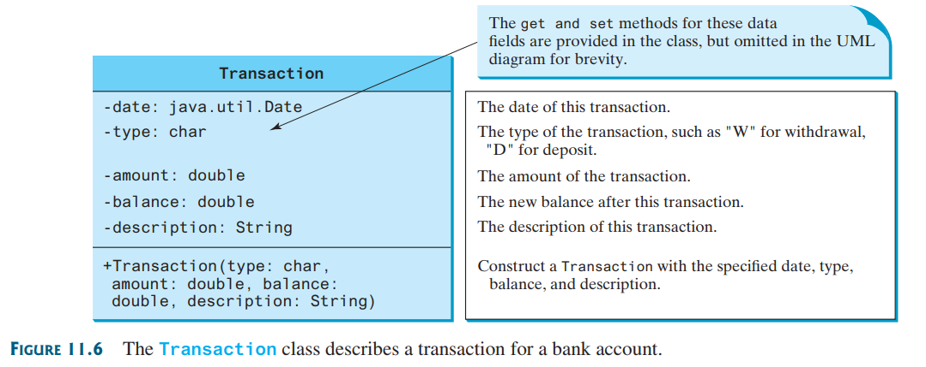
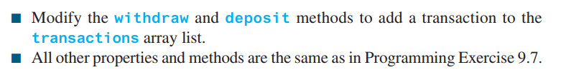
Practice

Slide 65
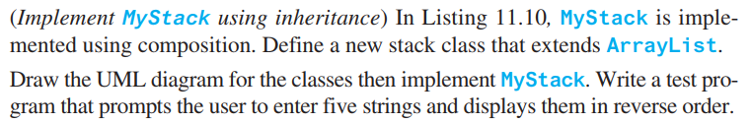
Practice

